Slide 1
LEAGUE OF NATIONS
The League of Nations was an international organization, headquartered in Geneva, Switzerland, created after the First World War to provide a forum for resolving international disputes to prevent the world from another war
10TH JANUARY 1920
Concert of Europe
Woodrow Wilson

Slide 2
OBJECTIVES OF THE LEAGUE
IN ORDER TO PROMOTE INTERNATIONAL COOPERATION AND TO ACHIEVE INTERNATIONAL PEACE AND SECURITY
BY THE ACCEPTANCE OF OBLIGATIONS NOT TO RESORT TO WAR
BY THE PRESCRIPTION OF OPEN, JUST AND HONOURABLE RELATIONS BETWEEN NATIONS
BY THE FIRM ESTABLISHMENT OF THE UNDERSTANDINGS OF INTERNATIONAL LAW AS THE ACTUAL RULE OF CONDUCT AMONG GOVERNMENTS,
BY THE MAINTENANCE OF JUSTICE AND A SCRUPULOUS RESPECT FOR ALL TREATY OBLIGATIONS IN THE DEALINGS OF ORGANISED PEOPLES WITH ONE ANOTHER

Slide 3
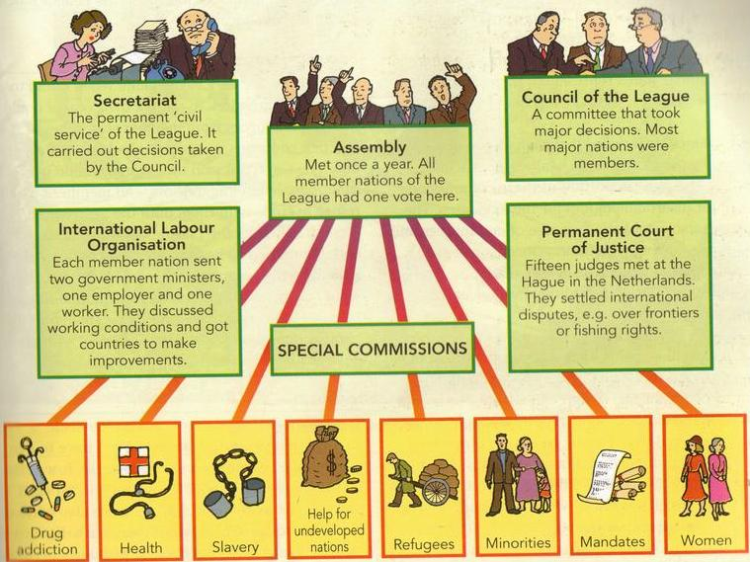
STRUCTURE OF THE LEAGUE

Slide 4
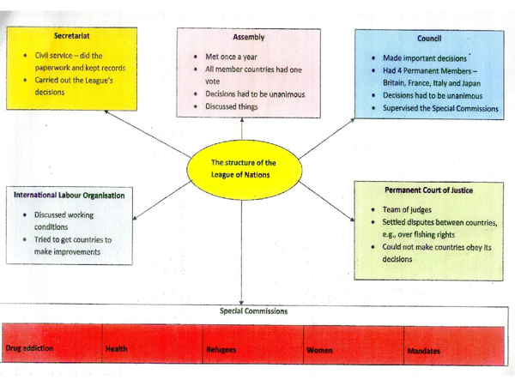
STRUCTURE OF THE LEAGUE

Slide 5
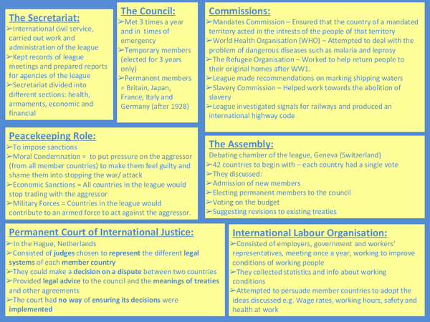
ORGANISATION AND FUNCTION

Slide 6
ACHIEVEMENTS OF THE LEAGUE
DISPUTE BETWEEN YUGOSLAVIA AND ALBANIA 1920
ALAND ISLANDS DISPUTE BETEEN SWEEDEN AND FINLAND 1920-1921
RESCUING AUSTRIA FROM ECONOMIC DISASTER
DISPUTE BETWEEN POLAND AND GERMANY 1921
DISPUTE BETWEEN IRAQ AND TURKEY 1924
DISPUTE BETWEEN GREECE AND BULGARIA 1925

Slide 7
FAILURES OF THE LEAGUE
LITHUANIA AND POLAND ISSUE 1920
RUSSO POLISH WAR 1920-1921
GREECE TURKEY WAR 1920-1921
AGGRESSION OF LITHUANIA INTO MEMEL 1923
INVASION OF RUHR BY FRANCE AND BELGIUM 1923
ANNEXATION OF CORFU, GREEK ISLAND BY ITALY 1923
THE MANCHURIAN AFFAIR 1931-1933
ALBANIAN ISSUE: GERMANY AND ITALY INVADED 1935
RHINELAND DISPUTE BETWEEN GERMANY AND FRANCE 1936
SPANISH CIVIL WAR 1936-1939
AGGRESSION OF GERMANY AND AUSTRIA 1938

